Slide 1

FINANC’S REPORT
NORDIC RETAIL GROUP
2026

Slide 2
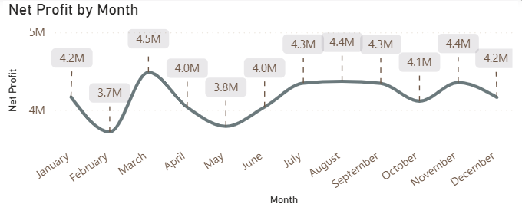
PROFITABILTY
Net profit exhibits a fluctuating but generally stable trend, peaking significantly in March ($4.5M) while maintaining a consistent baseline above $3.7M throughout the fiscal year
NORDIC RETAIL GROUP
2026

Slide 3
PROFITABILTY
Net profit exhibits a fluctuating but generally stable trend, peaking significantly in March ($4.5M) while maintaining a consistent baseline above $3.7M throughout the fiscal year
NORDIC RETAIL GROUP
2026

Slide 4
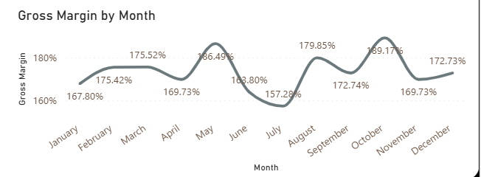
GROSS MARGIN
Gross Margin exhibits high monthly volatility throughout the year, reaching a peak of 189.17% in October following its lowest point of 157.28% in July
NORDIC RETAIL GROUP
2026

Slide 5
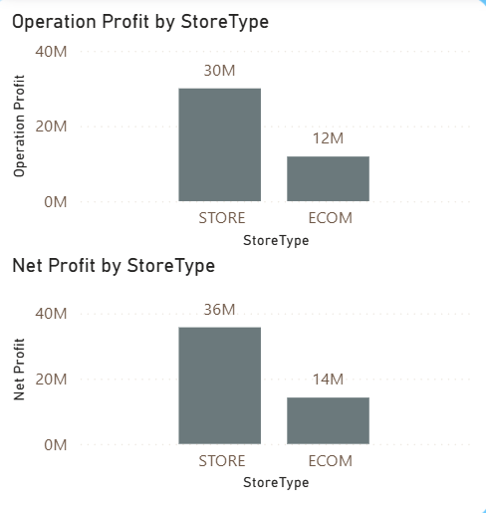
GROSS MARGIN
Physical stores act as the primary operational driver for the business, generating $30M in profit and nearly tripling the output of the E-commerce channel
Total bottom-line performance is led by physical retail locations, which contribute $36M in Net Profit compared to the $14M derived from digital sales
NORDIC RETAIL GROUP
2026

Slide 6
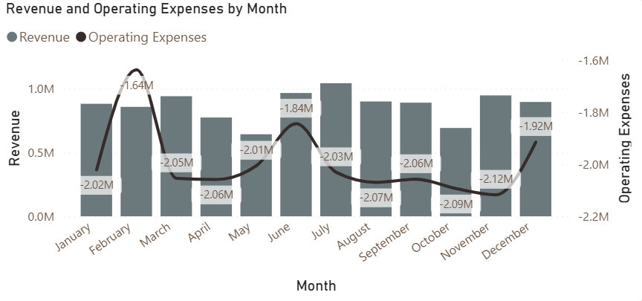
OPERATION
February shows a spike in expenses (~-1.64M) without a proportional revenue increase
Mid-year (June–July) revenue improves, but expenses remain elevated (~-2.0M)
End of year shows expense increase again (~-1.92M) with only modest revenue growth
NORDIC RETAIL GROUP
2026

Slide 7
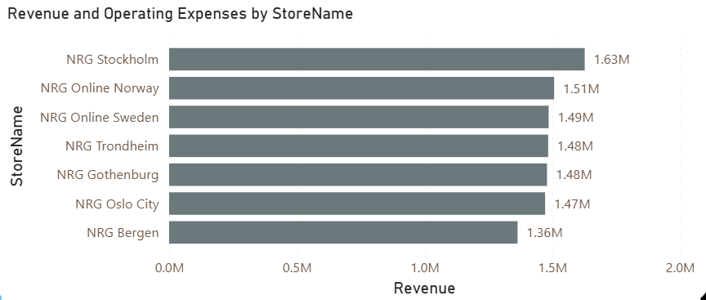
OPERATION
NRG Stockholm is the top-performing location with $1.63M in revenue, leading a highly consistent field where the majority of top-tier stores maintain a narrow performance range between $1.47M and $1.51M
NORDIC RETAIL GROUP
2026

Slide 8
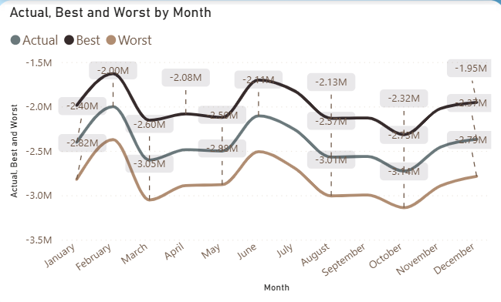
SCENARIO ANA
This chart compares Actual, Best Case, and Worst Case scenarios across stores, illustrating potential variations in financial performance under different business conditions.
It is designed to:
Evaluate business sensitivity to change
Identify risk exposure and upside potential
Support strategic decision-making under uncertainty
NORDIC RETAIL GROUP
2026

Slide 9
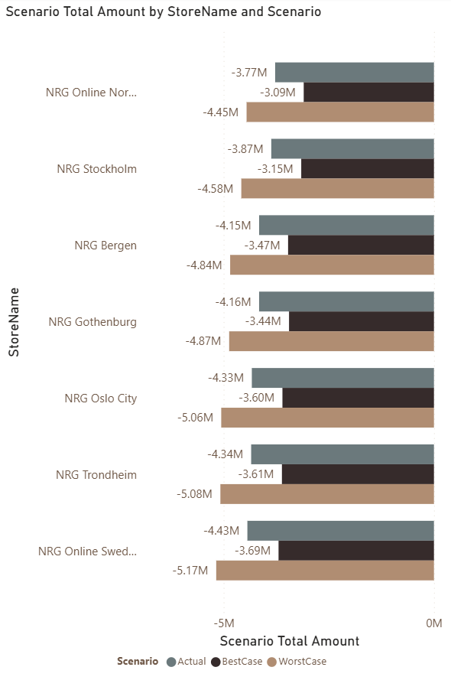
Systemic performance gap: All stores are ~17% below Best Case → indicates a company-wide structural issue, not isolated underperformance
Uneven store resilience: Best performer is NRG Online Norway (~ -$3.77M), while NRG Online Sweden & NRG Trondheim face highest downside risk (~ -$5M+)
Urgent cost optimization needed: A ~$5M gap to Best Case requires immediate company-wide improvements in logistics and marketing efficiency
NORDIC RETAIL GROUP
2026

Slide 10
Recommendation & Action
Cost Optimization (Priority) Optimize operational efficiency during the volatile first half of the year to replicate the sustained high-profit stability observed in the third quarter.
Improve Operational Efficiency Align expenses with revenue performance Replicate strategies from top-performing stores
Strengthen Business Channels Improve performance of underperforming channels (e-commerce) Optimize investment allocation across channels
Scenario-Based Planning Use scenario analysis for budgeting and forecasting Focus on closing the ~$5M gap to Best Case
NORDIC RETAIL GROUP
2026

